Slide 1


Machine Learning - Predicting Tipping for Taxi Riders in NYC
Philip Teri
Data Science Capstone Project, 2021
Thanks to my mentor at Springboard
Ryan McCormack
Notes:
Who I am
What program i took
How this project is relevant
Gis background and company
Digitizing and labelling of spatial data
Automating with deep learning
Add an image of digitizing roads or an example of it.

Slide 2
The Problem
Make predictions about how much a rider will tip.
This can be used by the taxi service or new ride sharing programs.
The goal is to make future insights using current data.

Slide 3
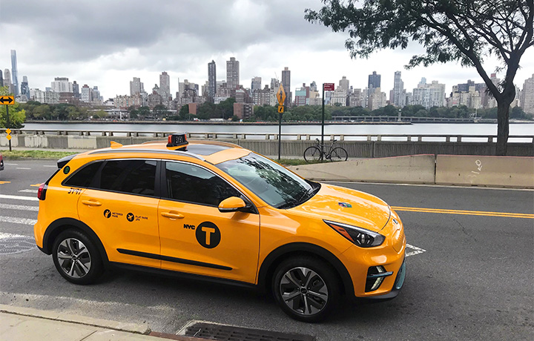
Data Source - NYC Taxi and Limousine Commission
Data sets are organized by month and year.
Each month can be downloaded as a csv file.
https://www1.nyc.gov/site/tlc/index.page

Slide 4
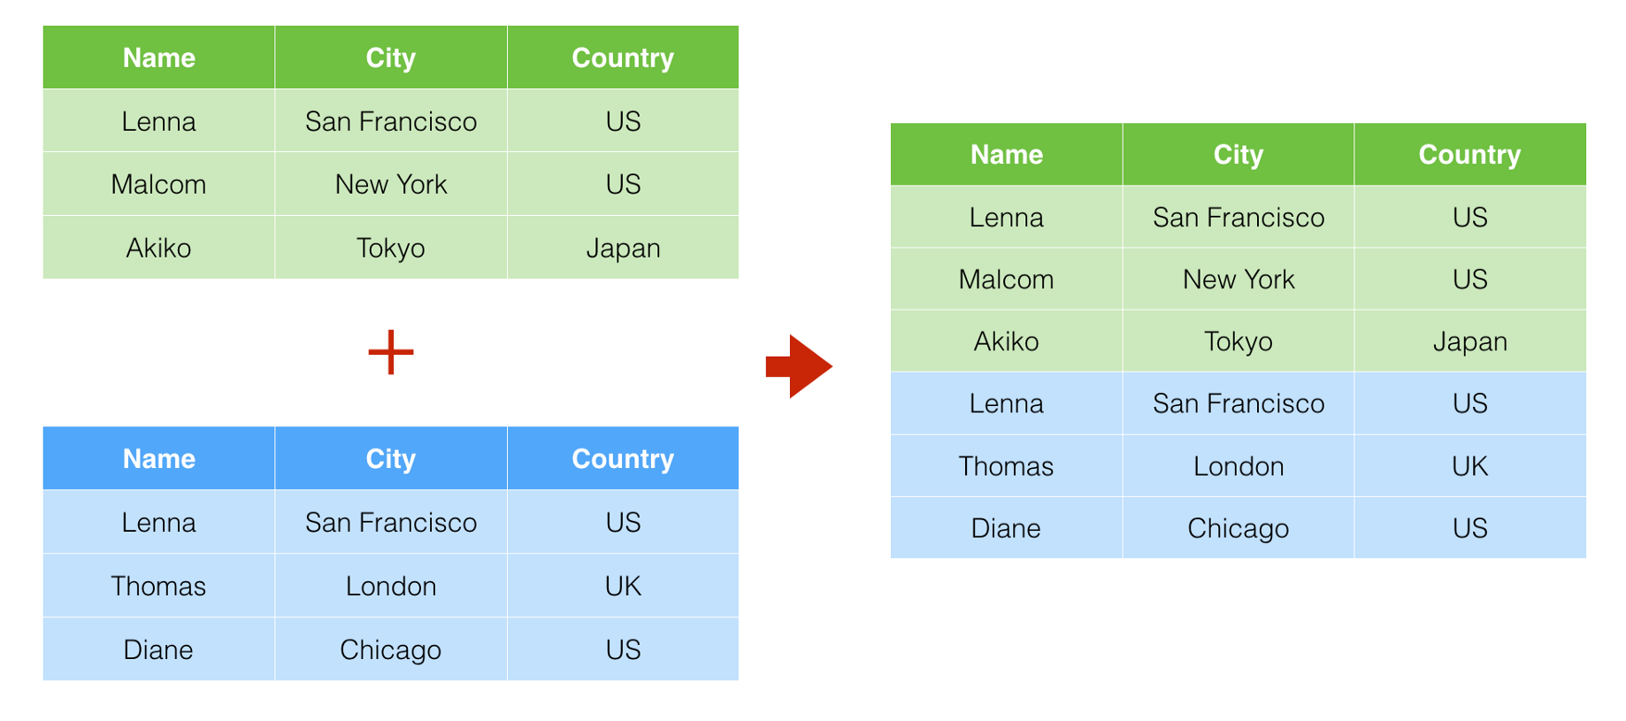
Data Wrangling
Combined 3 months of data into one dataframe
March, June, November of 2017

Slide 5
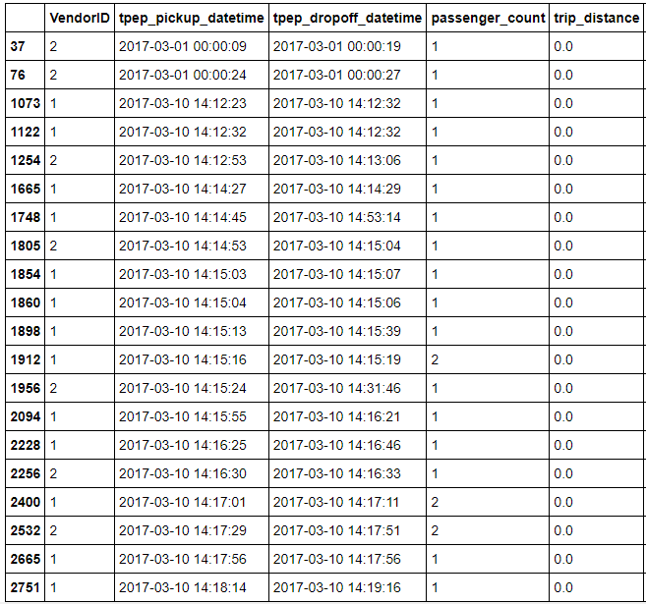
Data Cleaning
Removing Duplicates.
Removing rows with values of 0 in certain columns.
Example: Trip distance should not be 0, this indicated a trip was likely cancelled.

Slide 6
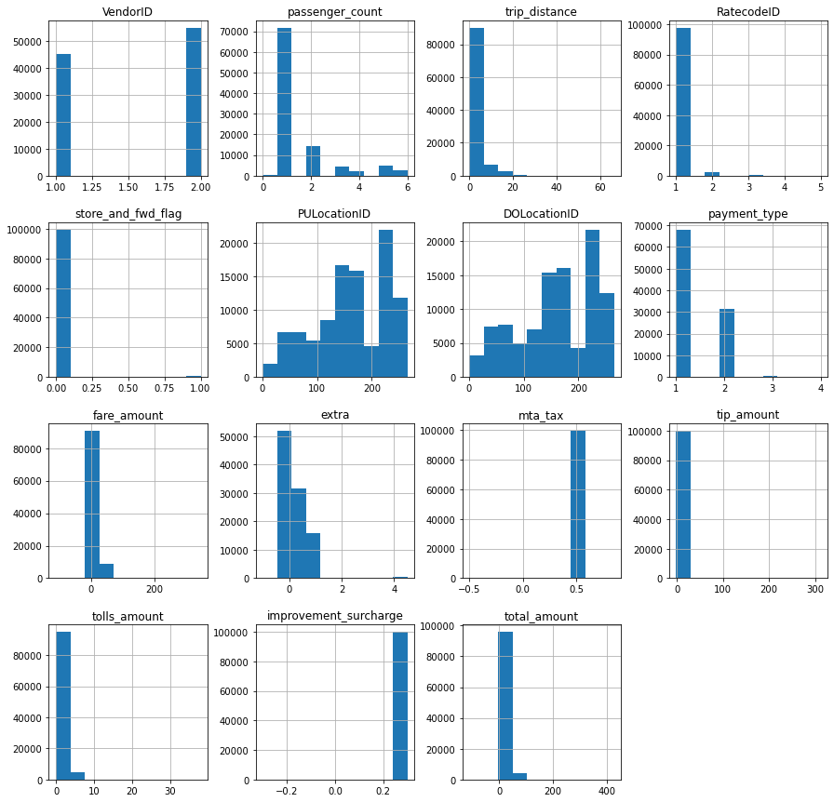
Exploratory Data Analysis
Data is highly skewed, for example trip distance.
Some variable are set rates, so they should be removed (mta_tax, improvement_surcharge).

Slide 7
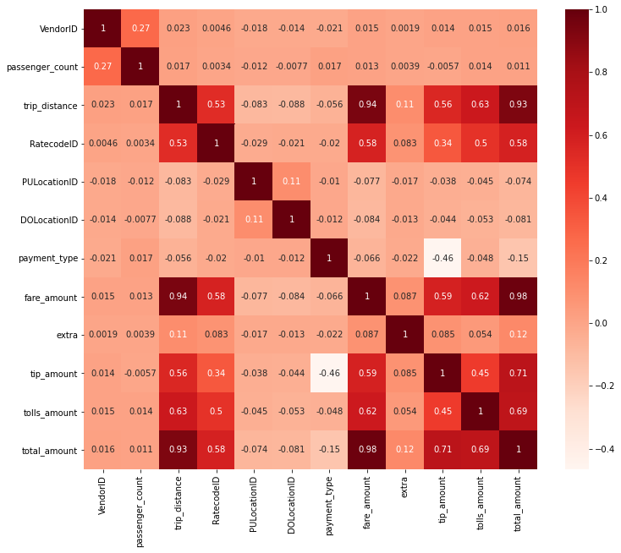
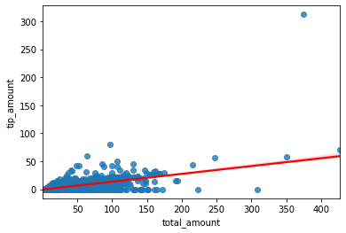
Exploratory Data Analysis
Strong correlation between tip and total amount.
Initially I thought there would be a strong linear correlation between tips and total amount but it is not as strong as I expected.

Slide 8
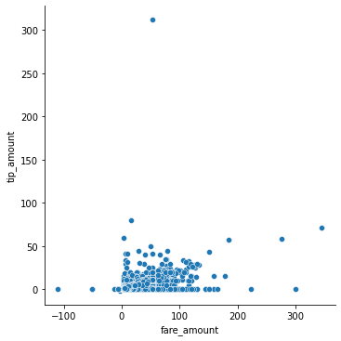
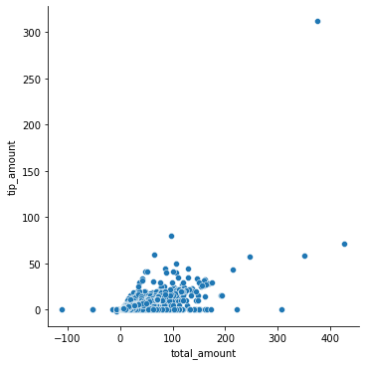
Exploratory Data Analysis
Negative fare and total amounts due to chargebacks, these rows are removed.
Weak positive correlation between tips and total amount.

Slide 9
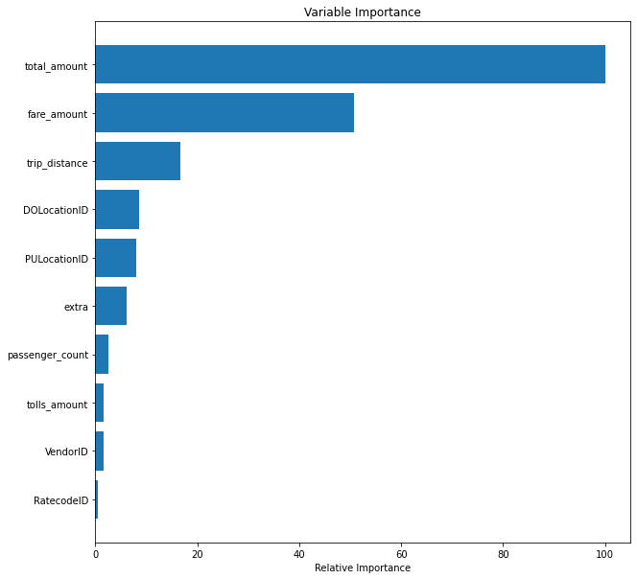
Results
Random Forest Accuracy Score: 0.93
KNN Accuracy Score: 0.62
Linear Regression Coefficient of Determination: 0.45
Total amount paid is the most important feature in this dataset in predicting tipping.
Linear regression was not very successful in predicting tips.
Random forest performed the best of all algorithms.

Slide 10
Future Improvements
Using more data from different months and years.
Creating different features and testing how they change the results.
Remove some of the bigger outliers.

